Slide 1
Year 1
Welcome to Meet the Teacher
September 2022

Slide 2
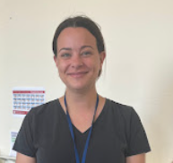
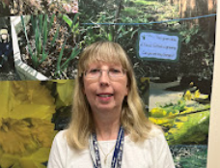
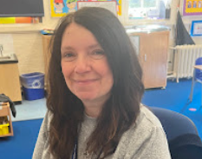
Staff in 1W
Miss Thompson Class Teacher | Mrs Simmons Class TA | Miss Jones (Tuesday PM) PPA Cover

Slide 3
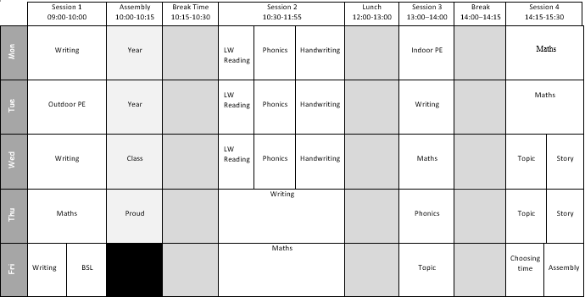
Timetable
P.E. days:
PE Kit: White T shirt, shorts/tracksuit bottoms/sweatshirt in school colours
Trainers/black plimsolls

Slide 4
Drop off and pickups
Start of the Day
09:00 Registration
09:10 Marked as late and must come into school through the main office
End of the Day
15:30 End of the day
15:40 Late collection and must pick up from the main school office

Slide 5
Uniform
Footwear:Black flat sensible, safe shoes or ankle high boots with good grip on the sole. Alternatively, smart, black trainers with no white or coloured flashes or patterns. Bright coloured laces are not permitted
High heels, flip flops, open-toed sandals, steel toed shoes/boots and greater than ankle high boots are unsafe & not appropriate for school. Pupils may wear boots to/from school but will need to bring a pair of shoes to change into
It is our school policy that all children wear school uniform when attending school. School uniform is part of the school ethos and in sending their children to James Wolfe Primary School, parents agree to support our policy.
Our uniform consists of:
White polo shirt
Navy blue sweater or cardigan (we promote the wearing of jumpers/polo shirts with logos but plain versions in the school colours are acceptable)
Black or grey trousers, shorts or skirts
Blue checked dress
Plain socks or tights in school colours (white, black, navy blue or grey)
Plain headscarves in school colours
Plain and discreet headbands and hair ties
A peaked cap for summer protection (sunglasses are not permitted)
Jewellery: It is encouraged that pupils do not wear jewellery to school, especially as individuals become very upset if a treasured piece of jewellery goes missing or is damaged. The only acceptable items of jewellery permitted are small studs for pierced ears and sensible watches. Please note that the school will be unable to take any responsibility for any jewellery/watches lost or damaged.
Make up: No make-up is to be worn to school (this includes nail polish)
Please label all school clothes with your child’s name. We do our best to re-unite children with clothes they leave lying around the playground and building.

Slide 6
Home learning
Reading
Yellow Reading Record: Record your child’s reading in this. We recommend reading every day for 5/10 minutes
Coloured level book
Book of choice
Collins E-Book
Home Learning
Home Learning Book: Record your child’s learning at home in this. We recommend two activities per week
Home learning Grid

Slide 7
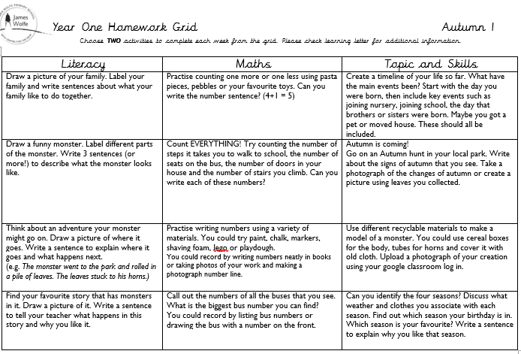

Slide 8
Statutory testing
Year 1
At the end of the summer term, the children will take a phonics screening check. The assessments are an indicator of how the children are progressing in their reading

Slide 9
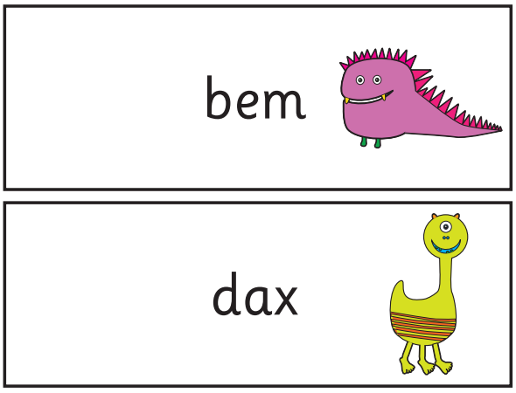
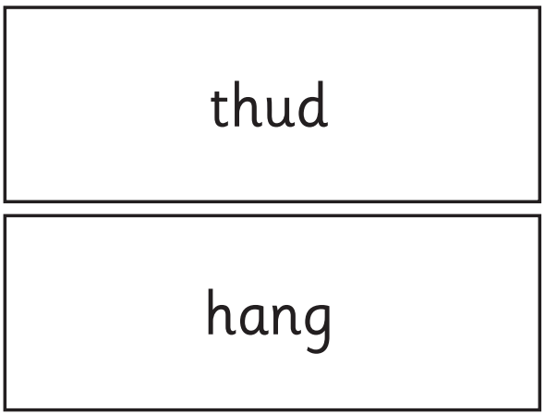

Slide 10
Special educational needs and or disabilities (SEND)
The SEND coordinator (SENDCo) at James Wolfe Primary School and centre for Deaf children is Carol Minkoulou
If you have any SEND related concerns, please remember that your class teacher is the first point of contact, as they are the people in class with your children each day. Your class teacher will then share these concerns with Ms Minkoulou so appropriate support can be put in place if needed.

Slide 11
Communication
Class teacher is your first point of contact- please contact admin@jameswolfe.greenwich.sch.uk who will then forward your message.
You will receive a weekly newsletter via Google Classroom which will provide you with the learning from the week and key dates
School website - https://www.jameswolfe.greenwich.sch.uk/

Slide 12
Parent reps
A Parent rep, represents all the parents and carers within you class. The role will involve supporting the teaching with fundraising, helping with FOJW and sharing the views and questions of the whole class, making it much easier to answer questions and queries and take on board suggestions.
We are looking for at least 2 parent reps per class
If you would live to be a parent rep, please admin@jameswolfe.greenwich.sch.uk

Slide 13
We are very excited about working with you and your wonderful children!

