Slide 1
Colours

Slide 2
blue
purple

Slide 3
green
red

Slide 4
pink
yellow

Slide 5
black
brown

Slide 6
white
orange

Slide 7
grey

Slide 8
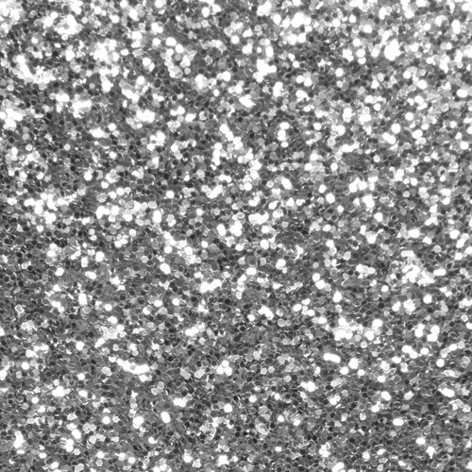
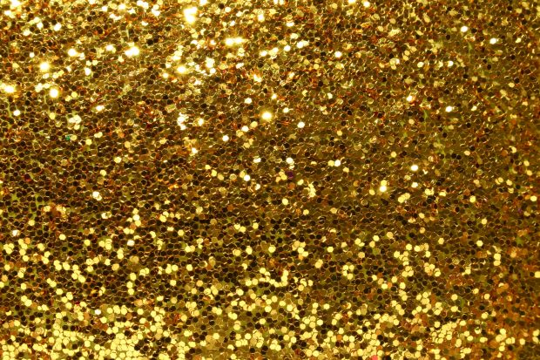
silver
gold

Slide 9
Like
Dislike

