Slide 1
Year 6
Welcome to Meet the Teacher
September 2023

Slide 2
Staff in Year 6
Teachers Ms Bedding (Lead) Miss Britton Ms Edgington Ms Cope | Support Staff Ms Collins (1:1) Ms Murray Ms Murray Ms Saunders (PPA) Mr Junior (PPA)

Slide 4
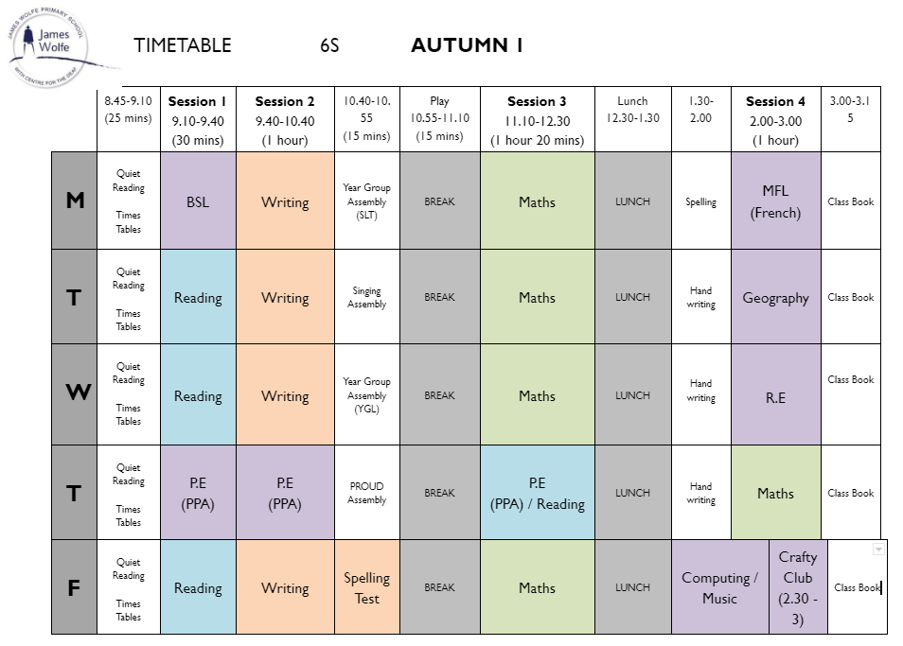
Timetable
Although this is our timetable, things may change. We will prepare children, where appropriate for these changes and inform you if you need to send in PE kit on an alternative day.
This is an example timetable, the slots for the below subjects will change depending on the class.
-PE
-BSL
-Library

Slide 5
P.E (PPA)
P.E. days:
PE Kit: White T shirt, shorts/tracksuit bottoms/sweatshirt in school colours
Trainers/black plimsolls
Swimming: swimming costume/trunks/jammers, towel, swimming hat for long hair. Please note the swimming pool do not permit goggles without a medical note
AM PE:
If children have PE in the morning, they should come to school in their PE kits but bring their uniform. Children will then change into their uniform at the end of their session for the rest of the day.
PM PE:
If children have PE in the afternoon, they should come to school in their school uniform but bring their PE kits to change into for their PE session. Children can then go home in their kits.
This is so children are as hygienic as possible during the day and build an awareness/habits for healthy sports participation.

Slide 6
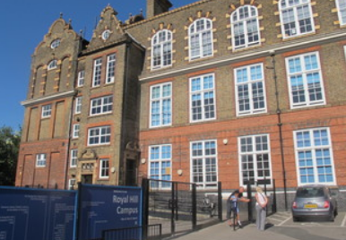
Drop off and pickups
Children should line up in the ball court (in their classes) at the beginning of the day, they will also be dismissed from the same place at the end of the day.
Please be aware that your child will be late if they arrive after 8.45am.
Year 4-6 - If you would like your child to walk home alone, please email and complete the form here.

Slide 7
Uniform
Footwear:Black flat sensible, safe shoes or ankle high boots with good grip on the sole. Alternatively, smart, black trainers with no white or coloured flashes or patterns. Bright coloured laces are not permitted
High heels, flip flops, open-toed sandals, steel toed shoes/boots and greater than ankle high boots are unsafe & not appropriate for school. Pupils may wear boots to/from school but will need to bring a pair of shoes to change into
It is our school policy that all children wear school uniform when attending school. School uniform is part of the school ethos and in sending their child to James Wolfe Primary School, parents agree to support our policy.
Our uniform consists of:
White polo shirt
Navy blue sweater or cardigan (we promote the wearing of jumpers/polo shirts with logos but plain versions in the school colours are acceptable)
Black or grey trousers, shorts or skirts
Blue checked dress
Plain socks or tights in school colours (white, black, navy blue or grey)
Plain headscarves
Plain and discreet headbands and hair ties
A peaked cap for summer protection (sunglasses are not permitted)
Jewellery: It is encouraged that pupils do not wear jewellery to school, especially as individuals become very upset if a treasured piece of jewellery goes missing or is damaged. The only acceptable items of jewellery permitted are small studs for pierced ears and sensible watches. Please note that the school will be unable to take any responsibility for any jewellery/watches lost or damaged.
Make up: No make-up is to be worn to school (this includes nail polish)
Please label all school clothes with your child’s name. We do our best to re-unite children with clothes they leave lying around the playground and building.

Slide 8
Homework
The half termly homework grid is posted onto Google Classroom every Friday. It is suggested that one activity is completed a week and handed in by the following Wednesday, either in homework books or uploaded onto the assignment in Google Classroom.
Reading: Please read with your child for at least 10 mins, 5 days a week and record this in their reading records.
Times Tables: Please practise times tables with your child. Your child has an account on Times Table Rockstars.
Spellings: Spellings will be sent home each Friday and tested the following Friday. Children are able to use Spelling Shed to practise their spellings at home.

Slide 9
Statutory testing
Year 6
In May 2023, Year 6 pupils will sit their statutory end of Key Stage 2 SATs tests. The children will prepare for these through a broad and balanced curriculum. The teachers will support the children to help them feel confident and reduce any anxiety around the tests. The assessments are an indicator of how well the children have attained at the end of Year 6. You do not need to do anything additional at home to prepare them for these tests but we ask that you continue to read with your child and support them with their homework.
Sats week this year is Monday 13th May 2024 - Thursday 16th May 2024 and will run as below:
Monday 13th May 2024 - SPAG
Tuesday 14th May 2024 - Reading
Wednesday 15th May 2024 - Arithmetic and Reasoning 1
Thursday 16th May 2024 - Reasoning 2

Slide 10
Secondary transition
Apply for a secondary school place | Royal Borough of Greenwich

Slide 11
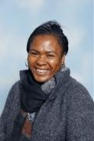
Special educational needs and or disabilities (SEND)
The SEND coordinator (SENDCo) at James WOlfe Primary School and centre for Deaf children is Carol Minkoulou.
If you have any SEND related concerns, please remember that your class teacher is the first point of contact, as they are the people in class with your children each day.
Your class teacher will then share these concerns with Ms Minkoulou so appropriate support can be put in place if needed.

Slide 12
Online Safety
Dear Parents,
Today, 12/9/23, PC Henry Lawton from the East Greenwich Safer Neighborhoods team visited us to talk to Years 5 and 6 about how to be safe online. We ask that you take this opportunity to talk to your child about online safety.
We are aware that many children have access to phones and other devices and often have an online presence. The most popular apps are Youtube, Snapchat, WhatsApp and Tiktok. Some have age ratings e.g. 13+ for Snapchat and Tik Tok, and 16+ for WhatsApp.
In the past, children have used these apps and we ask that if your child does, you:
Set up your child’s accounts together to make sure they sign up with the correct age. For some apps, this will automatically enable settings that help to limit unwanted contact from adults and access to certain features. Please look online before setting up to check for privacy settings.
Ensure that your child knows what personal and private information is, and what is, and is not, appropriate to share online. Speak to them about acceptable behaviour online and how to report any concerns they have.
Monitor your child’s access to these apps. Many apps have disappearing content but knowing that you are checking regularly and setting time boundaries will help.
The NSPCC has a lot of guidance around supporting your child online with up-to-date information about all new apps that become popular e.g. BeReal.
https://www.nspcc.org.uk/keeping-children-safe/online-safety/online-safety-blog/
Greenwich Safeguarding Children Partnership recently completed an online safety survey with children and young people. It shows an interesting and worrying local picture which is worth being aware of. Key findings include::
39% of children and young people said they have been sent something online that made them feel worried, uncomfortable or that they thought was wrong.
28% of children and young people have said something to someone online that they wouldn’t say to them in person.
41% of children and young people responded that they would not be happy for the adults they live with to know about everything they do on social media or online gaming.
At James Wolfe we take e-safety, including online bullying, very seriously. Please support us by taking time to monitor your child’s social media use, should you choose to allow them to use it.
Thank you,
Victoria Gallagher
.

Slide 13
Communication
Class teacher is your first point of contact
Email admin@jameswolfe.greenwich.sch.uk
Weekly Wolfe
School website - https://www.jameswolfe.greenwich.sch.uk/
Trips
To avoid unnecessary workload for parents, you will be informed about the school trips the children are taken on during the day (and we are asking for lots of volunteers!). We ask that you complete one form which will be sent tomorrow giving permission for your child to go on a trip. You will not need to give permission for each trip.
You can however speak to the class teacher for more information about individual trips should you have any queries.
https://docs.google.com/forms/d/e/1FAIpQLSfyqoG2krCR6MutzsvTeZHp5gkwnbk96pYr8XLDLmx_4pQg9g/viewform

Slide 14
Trip consent
Please note that parents are now asked to fill out one Google Form to give permission for ALL trips in Year 6.
This does not include trips that are outside of school hours, where a separate consent form will need to be completed.
You can find the link to this consent form below.
https://docs.google.com/forms/d/e/1FAIpQLSfyqoG2krCR6MutzsvTeZHp5gkwnbk96pYr8XLDLmx_4pQg9g/viewform?usp=sf_link

Slide 15
Parent reps
A Parent representative represents all the parents within you class and as well as supporting the Friends of James Wolfe.
The role will involve supporting the teaching with fundraising, helping with FOJW and sharing the views and questions of the whole class, making it much easier to answer questions and queries and take on board suggestions.
We are looking for at least 2 parent reps per year group.
If you would like to be a parent rep, please admin@jameswolfe.greenwich.sch.uk
We will have our first meeting on Friday 22nd September at 9:15am

Slide 16
We are very excited about working with your wonderful children!

