Slide 1
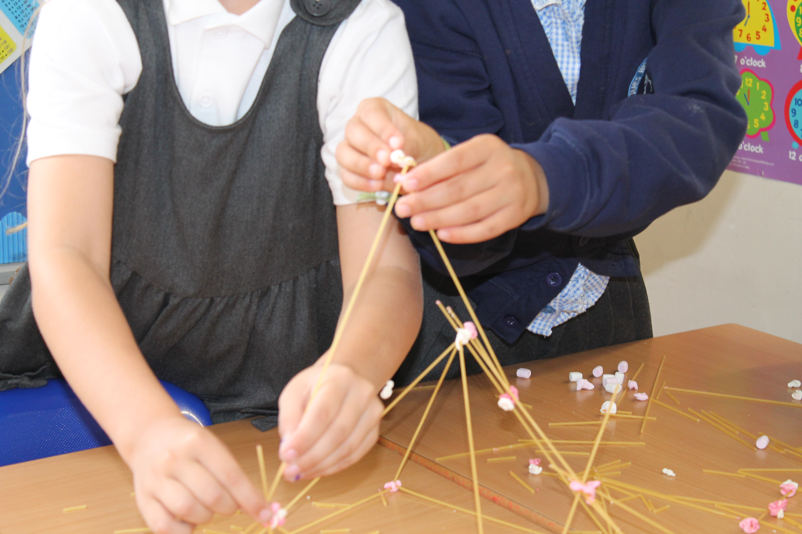
Year 3
Welcome to Meet the Teacher
Notes:
Slides 1 – 7 and 9 HK
Slides 8, 10 - 16 CA

Slide 2
Staff in 3 Ash
Class Teachers
Miss Ablett (3A) Year Lead | Picture | Miss Khorami (3C) | Picture

Slide 3
Staff in 3 Ash
Class Teachers
Ms Mistry (3O) | Picture | Miss Thompson (3P) | Picture

Slide 4
Staff in Year 3
Teaching Assistants
Ms Chambers
Ms Wright (1:1)
Ms Matthews (1:1)
PPA Cover – Mr Junior and Ms Saunders (Sports coaches)

Slide 5
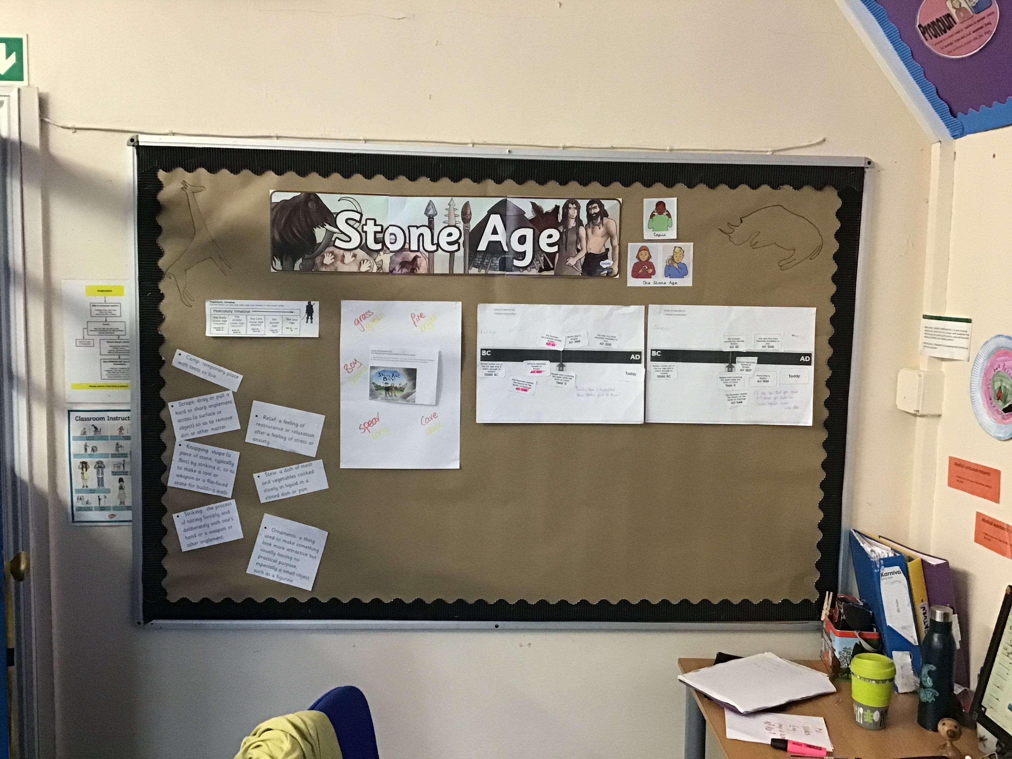
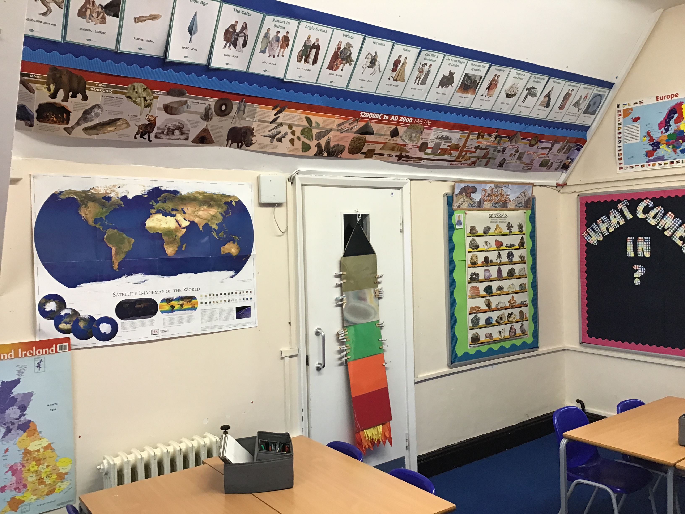
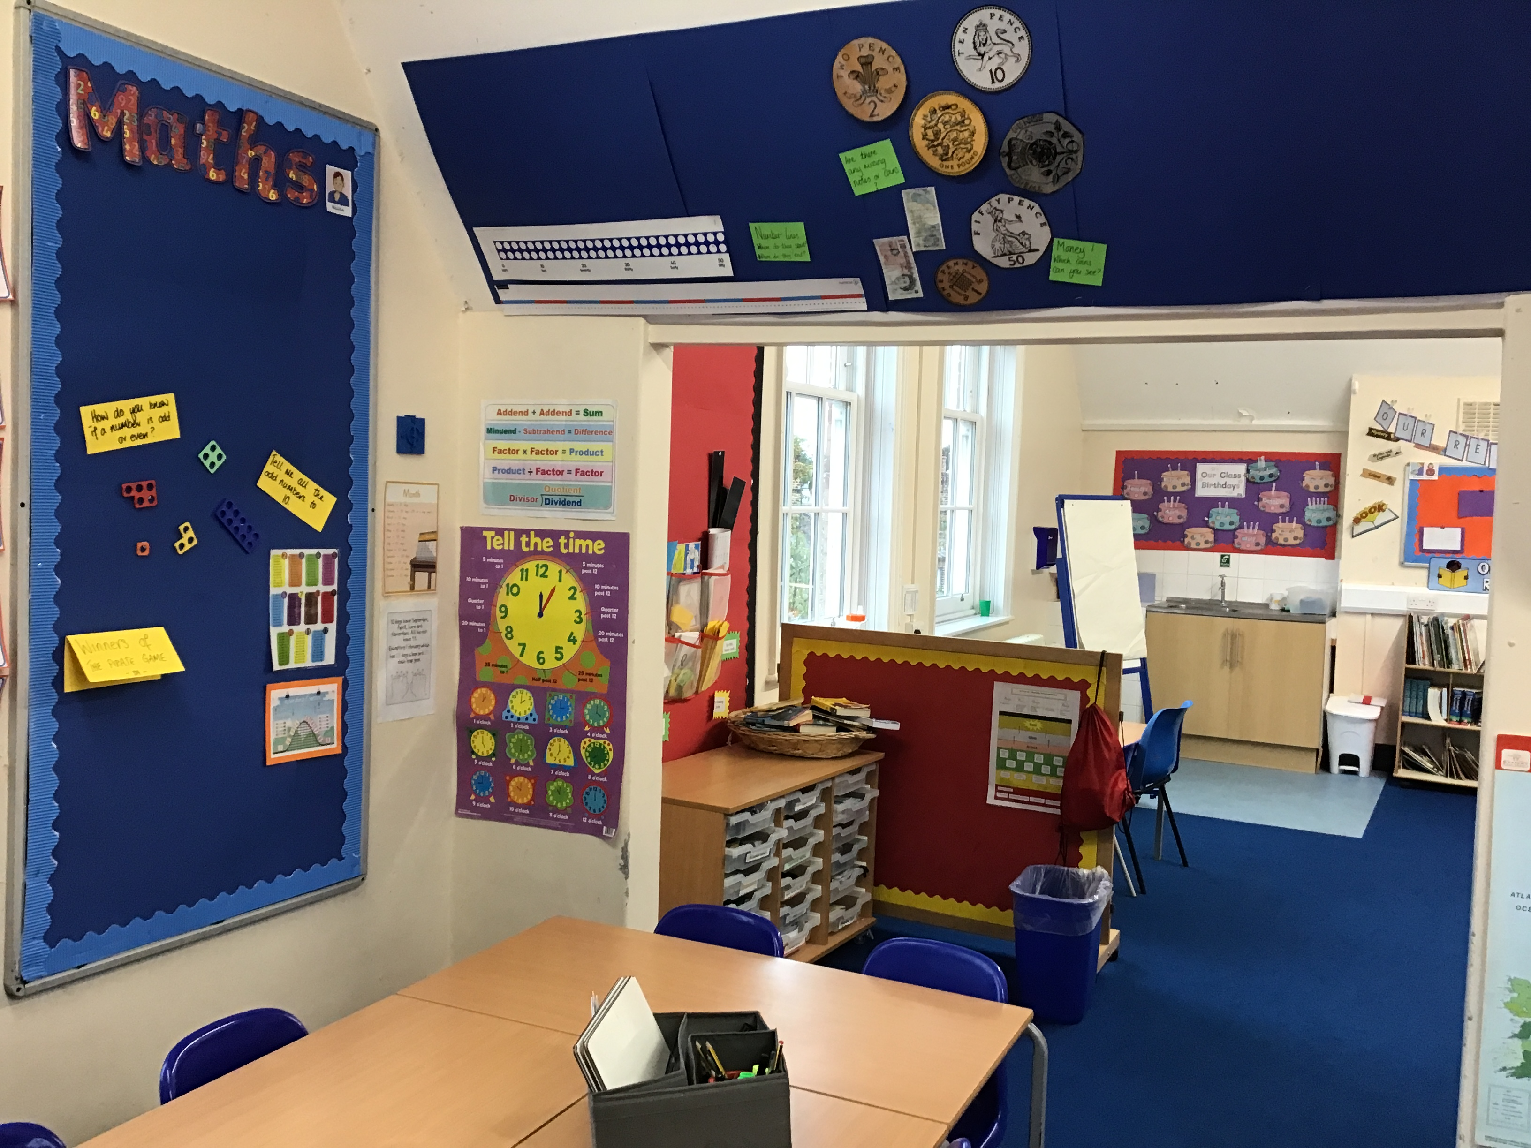
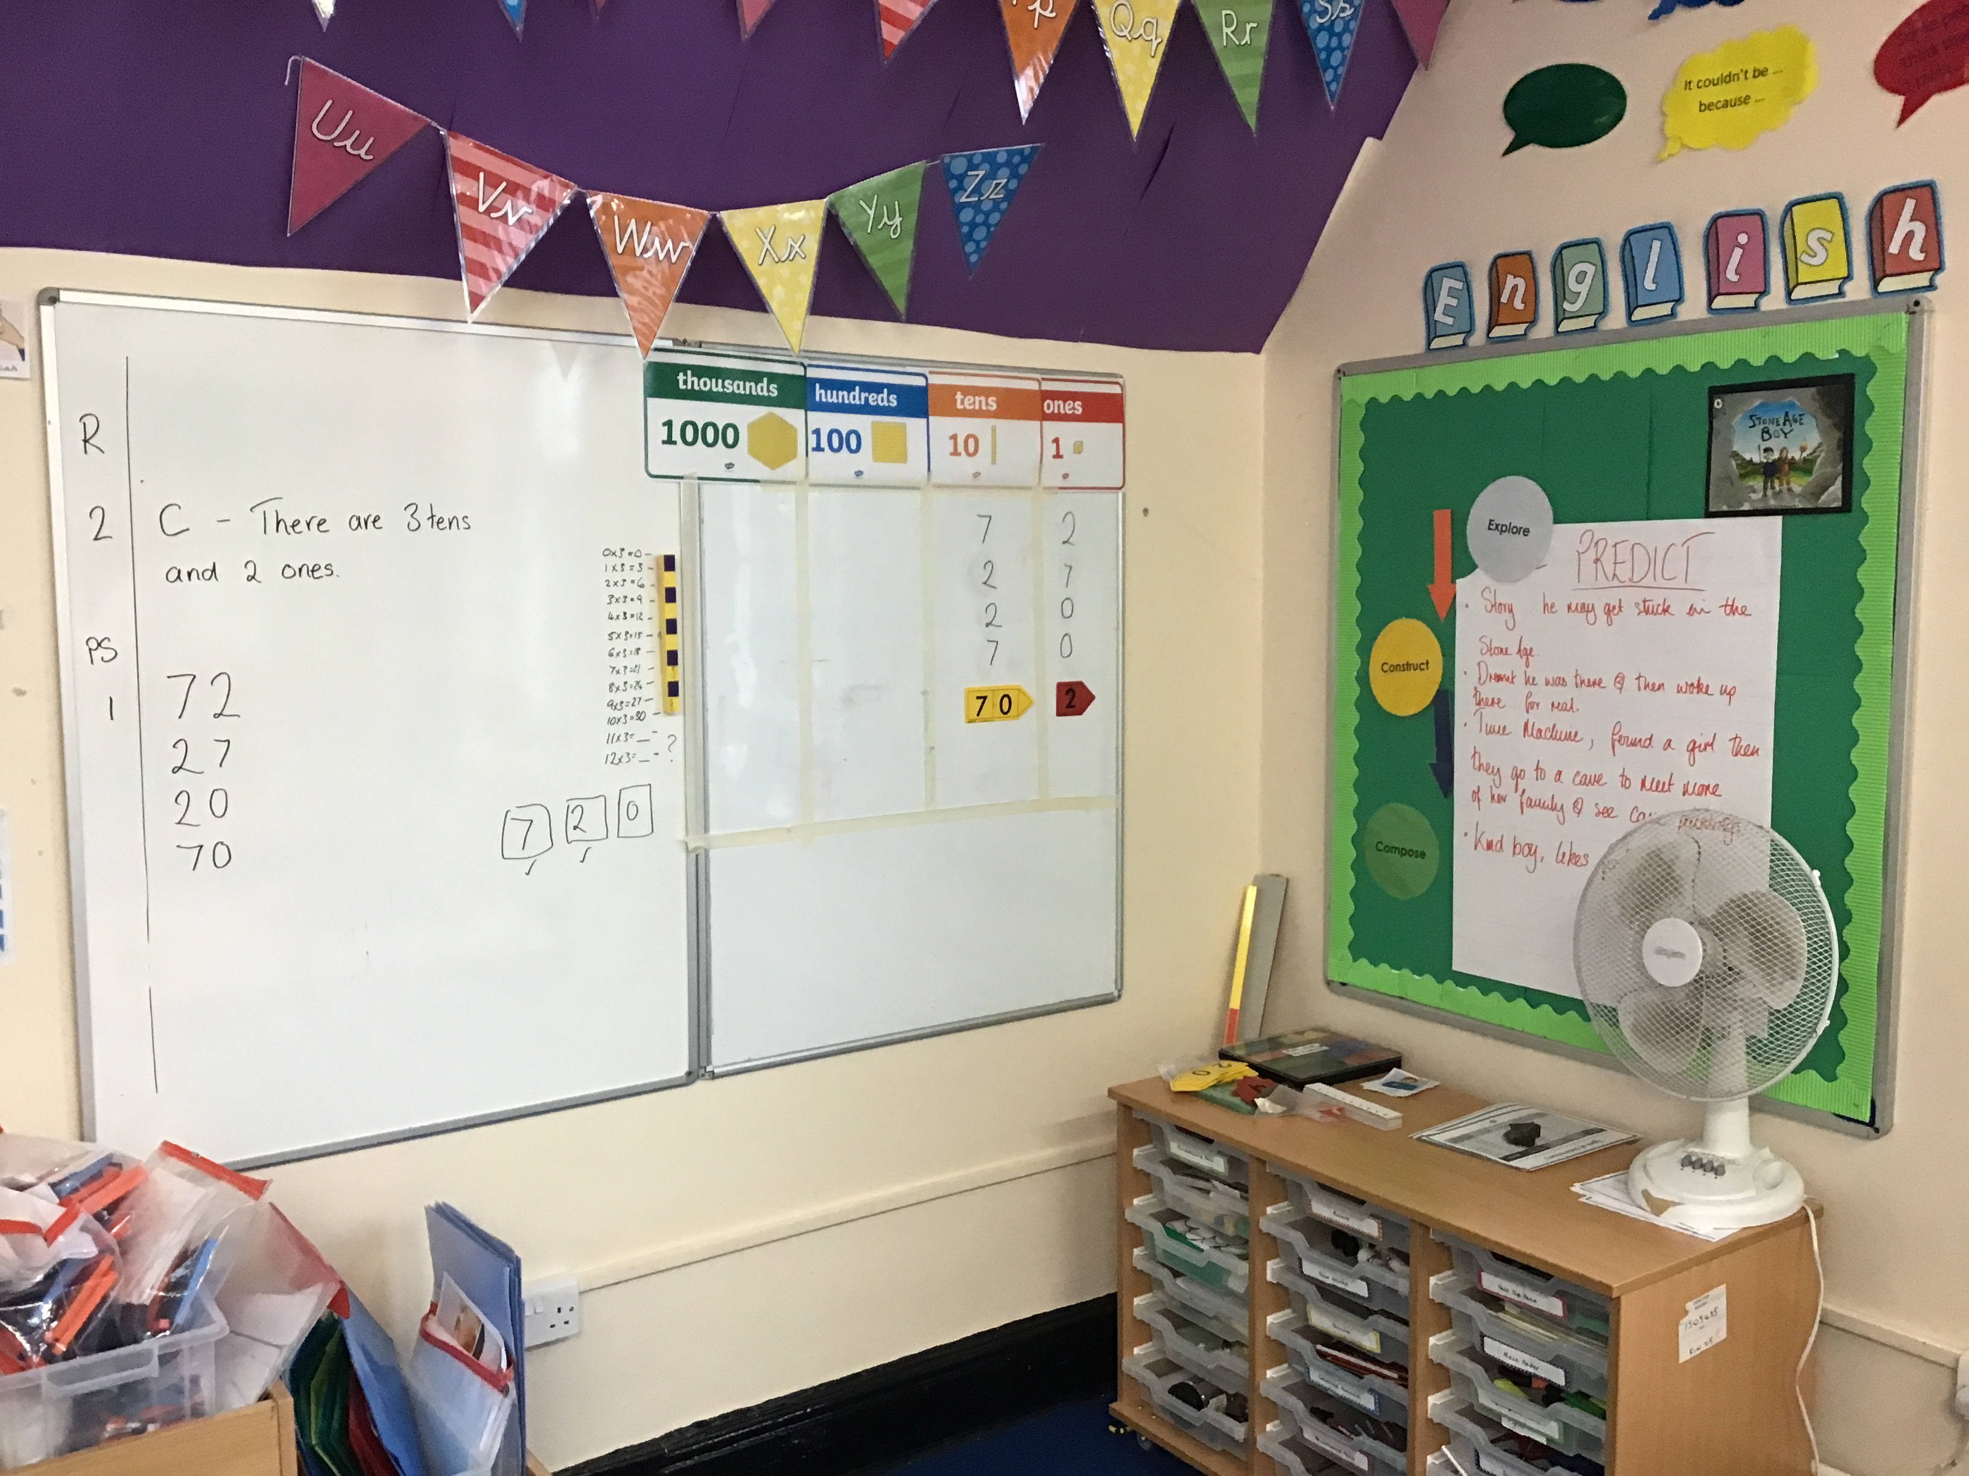
Classroom Location

Slide 6
Drop off and pickups
30 and 3P drop off and pick-up is under the canopy. Very useful if it rains!
3A and 3C drop off and pick-up is the play area next to the canopy.
Drop off is at 8.55am
Pick-up is at 3.25pm
Should you run late, please call the office and let them know. The children will be taken to the office if you are late as staff have meetings after school.
Please be aware that your child will be late if they arrive after 9.05am. Remember that the gate may still be open for Reception children but they will have missed the register in Year 3 and so MUST go to the office before class otherwise they will be marked as absent.

Slide 7
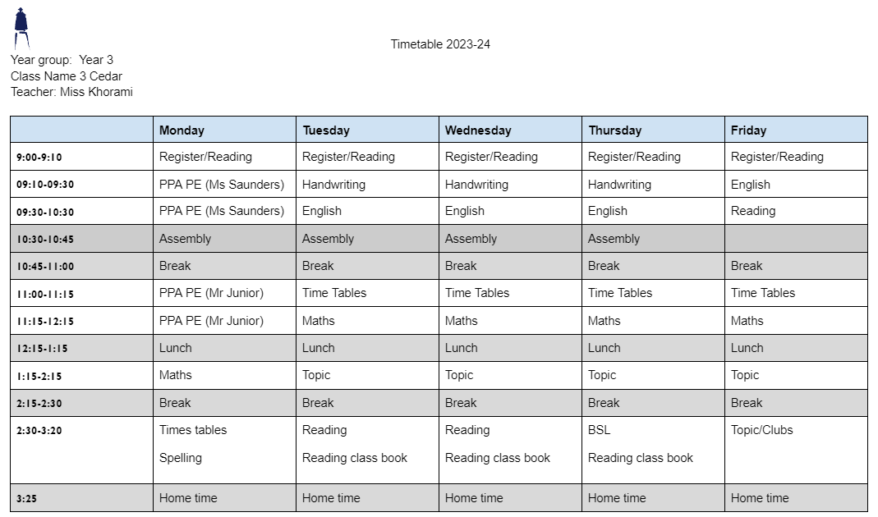
Timetable 3C
Although this is our timetable, things may change. We will prepare children, where appropriate for these changes and inform you if you need to send in PE kit on an alternative day.
P.E. days: Mondays
If your child has PE in the morning Classes 3O and 3C they can come in to school wearing their PE kit but they will need to change into their school clothes in the afternoon.
PE Kit: White T shirt, shorts/tracksuit bottoms/sweatshirt in school colours
Trainers/black plimsolls

Slide 8
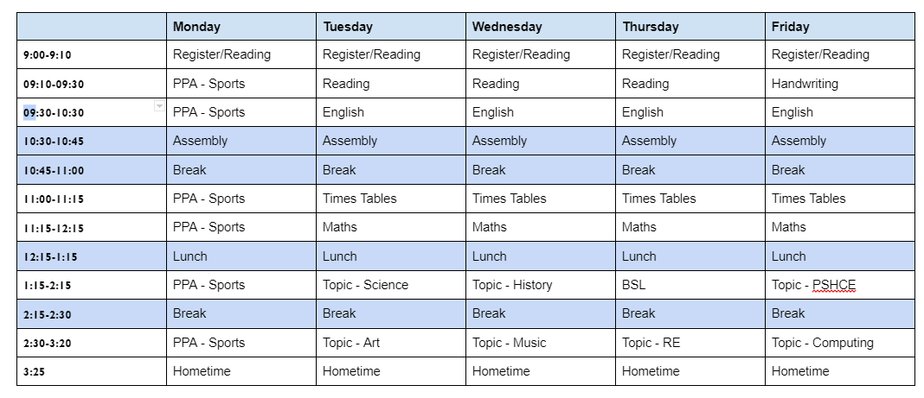
Timetable 3A
Although this is our timetable, things may change. We will prepare children, where appropriate for these changes and inform you if you need to send in PE kit on an alternative day.
P.E. days: Mondays:
If your child has PE in the morning Classes 3O and 3C, they can come in to school wearing their PE kit but they will need to change into their school clothes in the afternoon. 3P and 3A have P.E. in the afternoon so they will come in their school uniform and change into their P.E kit.
PE Kit: White T shirt, shorts/tracksuit bottoms/sweatshirt in school colours
Trainers/black plimsolls

Slide 9
Homework
Please read with your child for at least 15 mins, 5 days a week and record this in their reading records. The children should get either a book of their own choice or they will be directed to a book at an appropriate level for them (possibly phonologically linked).
Homework will be handed in on Wednesday and handed out on Friday. The children will have passwords stuck into their homework books so they can access Google Classroom, Spelling Shed, Read Theory and Timestables Rockstars homework.
Please practise timestables with your child. Your child has an account on Timestable Rockstars but this program focusses on division and we do not teach division as the inverse of multiplication until later in the year- We will let you know!
Spellings – We will follow Spelling Shed program which your child will receive a password for.

Slide 10
Uniform
Footwear: Black flat sensible, safe shoes or ankle high boots with good grip on the sole. Alternatively, smart, black trainers with no white or coloured flashes or patterns. Bright coloured laces are not permitted
High heels, flip flops, open-toed sandals, steel toed shoes/boots and greater than ankle high boots are unsafe & not appropriate for school. Pupils may wear boots to/from school but will need to bring a pair of shoes to change into
It is our school policy that all children wear school uniform when attending school. School uniform is part of the school ethos and in sending children to James Wolfe Primary School, parents agree to support our policy.
Our uniform consists of:
White polo shirt
Navy blue sweater or cardigan (we promote the wearing of jumpers/polo shirts with logos but plain versions in the school colours are acceptable)
Black or grey trousers, shorts or skirts
Blue checked dress
Plain socks or tights in school colours (white, black, navy blue or grey)
Plain headscarves in school colours
Plain and discreet headbands and hair ties
A peaked cap for summer protection (sunglasses are not permitted)
Jewellery: It is encouraged that pupils do not wear jewellery to school, especially as individuals become very upset if a treasured piece of jewellery goes missing or is damaged. The only acceptable items of jewellery permitted are small studs for pierced ears and sensible watches. Please note that the school will be unable to take any responsibility for any jewellery/watches lost or damaged.
Make up: No make-up is to be worn to school (this includes nail polish)
Please label all school clothes with your child’s name. We do our best to re-unite children with clothes they leave lying around the playground and building.

Slide 11
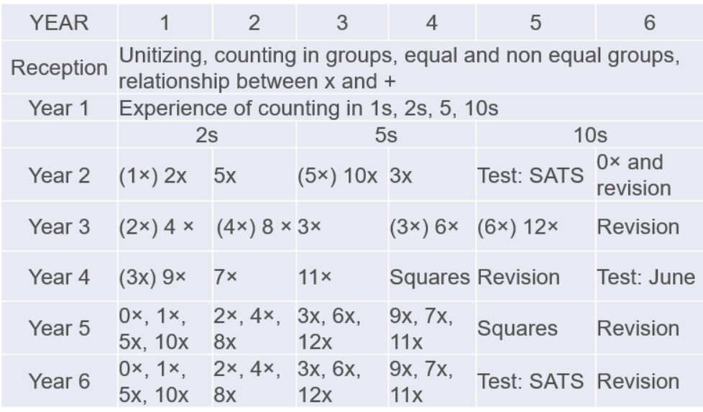
Statutory testing
Delete as appropriate
Year 3
In June of Year 4, the children will take a Multiplication test. The purpose of the MTC is to make sure the times tables knowledge is at the expected level so that they can access the Year 5 curriculum.
We start that journey here in Year 3. The teachers will be working on these with the children in class but a good way to prepare is start early and build a daily routine practising the times tables. The children also have access to Timestable Rockstars. We will share their login details with the children and share with families within the first few weeks of term. With regular practise the children will learn all the questions and gain confidence.

Slide 12
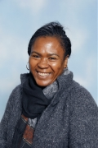
Special educational needs and or disabilities (SEND)
The SEND coordinator (SENDCo) at James Wolfe Primary School and Centre for Deaf Children is Carol Minkoulou.
If you have any SEND related concerns, please remember that your class teacher is the first point of contact, as they are the people in class with your children each day.
Your class teacher will then share these concerns with Ms Minkoulou so appropriate support can be put in place if needed.

Slide 13
Communication
Class teacher is your first point of contact- admin@jameswolfe.greenwich.sch.uk.
You will receive a termly year group newsletter via email, the website and Google Classroom.
Weekly learning updates will be posted on Google Classroom above the homework grid.
Trip and information letters are printed, emailed and posted on Google Classroom.
School website - https://www.jameswolfe.greenwich.sch.uk/
TRIPS
To avoid unnecessary workload for parents, you will be informed about the school trips the children are taken on during the day (and we are asking for lots of volunteers!). We ask that you complete one form which will be sent soon giving permission for your child to go on a trip. You will not need to give permission for each trip.
https://docs.google.com/forms/d/e/1FAIpQLSfyqoG2krCR6MutzsvTeZHp5gkwnbk96pYr8XLDLmx_4pQg9g/viewform
You can however speak to the class teacher for more information about individual trips should you have any queries.

Slide 14
Parent Reps
A Parent Representative represents all the parents within your class and as well as supporting the Friends of James Wolfe.
The role will involve supporting the teaching with fundraising, helping with FOJW and sharing the views and questions of the whole class, making it much easier to answer questions and queries and take on board suggestions.
We are looking for at least 2 parent reps per year group.
If you would like to be a parent rep, please email admin@jameswolfe.greenwich.sch.uk
We will have our first meeting on Friday 22nd September at 9:15am.

Slide 15
Any Questions?

Slide 16
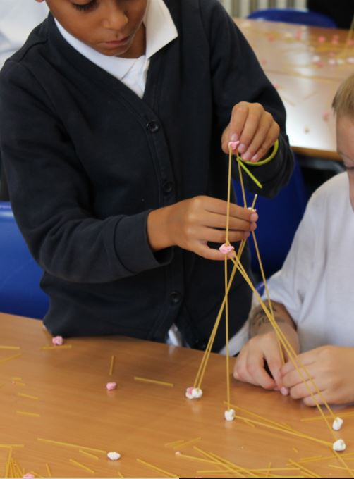
We are very excited about working with your wonderful children!

