Slide 1
L: We are learning the signs of the countries of the world. Have you been on a aeroplane on holiday and where did you go?

Slide 2

World

Slide 3
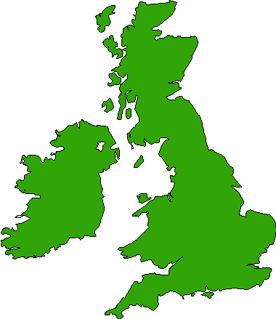
Great Britain

Slide 4


Ireland
Britain

Slide 5


Scotland
Wales

Slide 6



England
Russia

Slide 7


Spain
Italy

Slide 8



Germany
Turkey

Slide 9



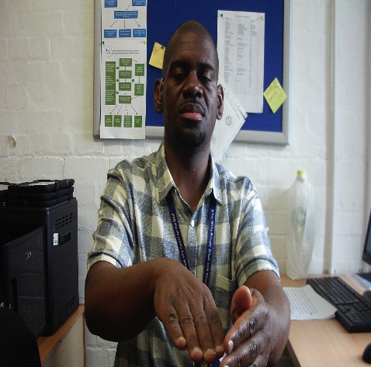

Jamaica
France

Slide 10


Poland
Norway

Slide 11


Portugal
Switzerland

Slide 12


Sweden
Belgium

Slide 13


Greece
Netherland

Slide 14


America
China

Slide 15



Mexico
Africa

Slide 16



India
Malaysia

Slide 17


New Zealand
Australia

Slide 18



Japan
Thailand

Slide 19
Thank you

